Slide 1
eRAP Reporting Project
5/17/2016
Notes:
Marisol

Slide 2
Agenda
eRAP Reporting Project Overview
Purpose
Benefits
Objectives
eRAP Reporting Committee
Pending Support Reports
Overview
Demo
Notes:
Marisol

Slide 3
Reporting Project Overview
Purpose
Deliver valid and stable Coeus proposal and award data
Deliver standard Contracts & Grants (C&G) enterprise reports
Enable the creation of ad hoc reports to users with appropriate access rights
Benefits
Replace QueryLink with new suite of enterprise reporting tools
Support the demand for accurate and validated C&G data required by departmental research administrators
Decrease institutional risk through quicker identification/resolution of problems with data
Provide self-service reporting capabilities
Notes:
Jason

Slide 4
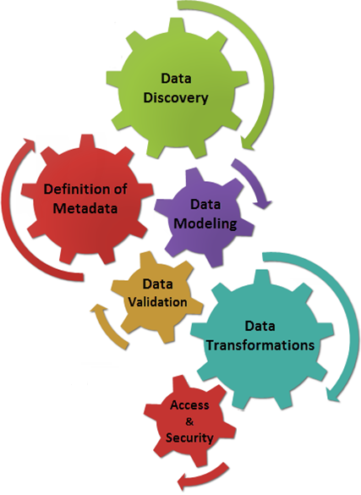
Reporting Project Overview
Objectives
Provide access to research administration data to approved UCSD users, while ensuring appropriate limitations to sensitive data
Provide transformed research data that is well documented by subject matter experts
Provide data that allows end users to quickly and consistently answer key business questions
Provide a single authoritative source of information which will reduce conflicting interpretations of research data
Notes:
Jason

Slide 5
eRAP Reporting Committee
Key Responsibilities
Comprised of representatives across all areas of campus
Identified and inventoried desired reports
Established clear ownership and governance of research data
Established data access guidelines
Ongoing: Prioritize reports based on available resources
Notes:
Linda

Slide 6
eRAP Reporting Committee
Current Priorities
Identified Current & Pending Support Report as highest priority project
Pending Support Report
Completed and available for all ePD on-boarded departments as of 4/13/16
Demo to follow
Award Data Model
In Progress – focus on making validated award data available to campus consumers
Current Support Report
To be started on completion of Award Data Model project
Notes:
Linda

Slide 7
Pending Support Reports
Report Name | Intended For
My Proposals | Investigators Intended to show a current list of pending proposals from ePD for a specific investigator
Selected PIs | Fund Managers/MSOs Intended to show a current list of pending ePD proposals for one or more investigators
Selected Units | Unit Heads/Assistant Unit Heads Intended to show the current portfolio of pending ePD proposals for one or more units
Notes:
Marisol

Slide 8
Report Demo
Notes:
Marisol

Slide 9
Pending Support Reports - Access
How to access these reports
Go to blink.ucsd.edu
From the Blink Topics menu, select Research
From the Research page, from the left hand navigation menu, select Data & Analytics
From the Data & Analytics page, select the Proposal Reports link
Or, you can search blink for eRAP Reporting Project to get to our Reporting Blink page
The direct link to the current eRAP Reporting Project page is:
http://blink.ucsd.edu/research/data-analysis/erap-reporting-project/index.html
Notes:
Marisol

Slide 10
Questions
Notes:
Marisol

