Slide 1
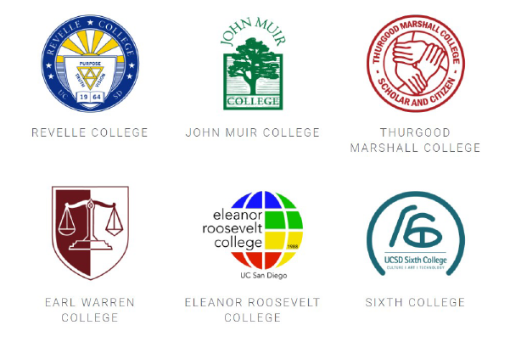
Undergraduate Research and High Impact Practices
A Colleges Proposal
which resonates with
UCSD 2014 Strategic Plan:
“Delivering an educational and overall experience that develops students who are capable of solving problems, leading, and innovating in a diverse and interconnected world”

Slide 2
We propose a colleges-based partnership to provide seed funding for
Undergraduate research, creative activities, and community service projects
Research-oriented seminars and workshops
Study and research abroad opportunities
This partnership includes, but not limited to, the following stakeholders:
Schools/Divisions/Departments/Programs faculty and advisors
Financial Aid
Academic Enrichment Program
International Education
Teaching and Learning Commons
Office of Research Affairs (ORA) : Organized Research Units (ORUs)/Research Centers

Slide 3
Undergraduate Research
Awards to students for faculty-mentored research projects and creative activities in:
Sciences
Social sciences
Engineering
Arts and Humanities
Public service projects and interdisciplinary activities
Awards features:
Faculty-mentored summer research
Academic quarter faculty-mentored research
Augment research experience with participation in conferences/publications

Slide 4
Seminars and Workshops
Goal: To provide seminars/workshops for preparing students the basic subject matter and research methods.
Colleges can partner with departments to tailor seminar for particular discipline.
Faculty, research scientists, graduate researchers, and affiliates are welcome to give guest lectures.
Some of the hands-on trainings can take advantages of campus recharge facilities.
The seminars can form a rich network of high-impact, research pipelines for some targeted student populations (e.g. transfer students, first gen., etc)

Slide 5
Study and Research Abroad
Leverage existing study abroad programs:
Education Abroad Program (EAP)
Opportunities Abroad Program (OAP)
Faculty-directed summer programs (Global Seminars)
Leverage research exchange programs under International Education:
The International Summer Undergraduate Research Program with various partner universities around the world.
Embedded Study Abroad Programs that involve preparatory coursework on campus, followed by global field research/projects during spring break or summer.
Campus-based student exchange programs emerged between departments and international institutions through research collaborations.

Slide 6
Implementation
Matching students with faculty mentors
Organizing and staffing seminars
Soliciting and evaluating research proposals, including developing electronic submission infrastructure
Vetting global education scholarship applications
Overseeing projects and budgets
Tracking project completion and assessing the impact on student success
Partnership with Academic Enrichment Program (AEP) in particular:
Identify existing faculty mentor networks (e.g., the Faculty Mentor Program, the First Gen Faculty initiative, etc.).
Identify faculty most interested in expanding research programs or exploring new areas of research.
Engage with consortia, ORUs, and ORAs.
Utilize AEP programs geared towards connecting students with faculty.

Slide 7
First Year Program Preliminary Plan
 | Number | Funding ($ per unit)
Seminars | 6 | 1500
Student research (3 quarters) | 50 | 3000
Student research summer | 20 | 5000
Workshops | 12 | 300
Student Travel To Conferences | 6 | 1000
Study Abroad | 60 | 3000

Slide 8
Q & A

